Slide 1
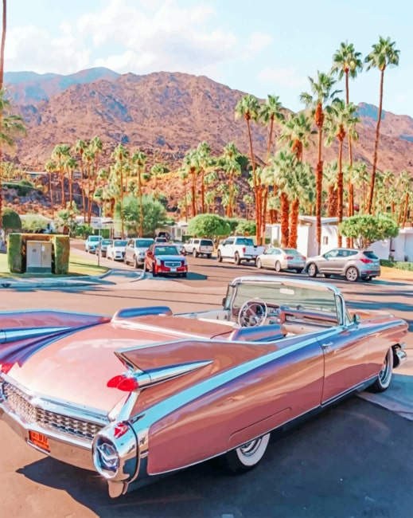
FORCES
AND VEHICLE SAFETY
CARS
CARS
CARS
//FASHION PHOTOGRAPHY WORKSHOP
By Piper Adams

Slide 2
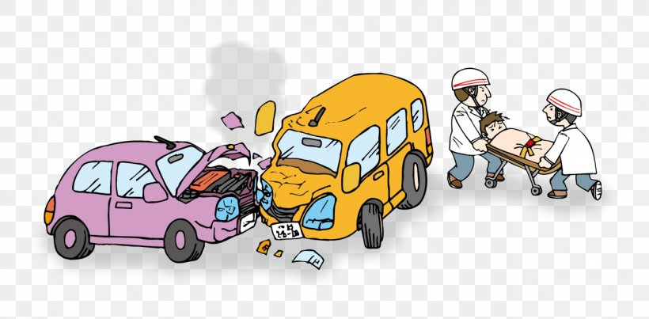
01
Increasing time of collision or the time it takes to stop
//FASHION PHOTOGRAPHY WORKSHOP

Slide 3
Increasing the collision time and/ or the time it takes the vehicle to stop allows the force of impact to be minimised so as to prevent catastrophic injury.
—Increasing the collision time means
having things like crumple zones and airbags
to reduce the force made on the person driving .
— The crumple zones allow the force to be captured thus leaving less force to impact the driver or passengers.
//FASHION PHOTOGRAPHY WORKSHOP

Slide 4
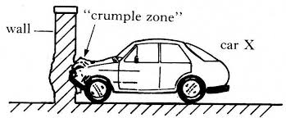
//FASHION PHOTOGRAPHY WORKSHOP

Slide 5
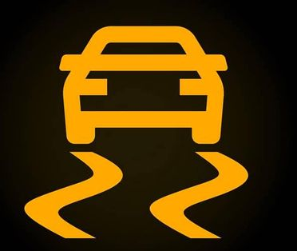
02
Spreading forces of impact over the largest possible area and ensuring stability
//FASHION PHOTOGRAPHY WORKSHOP

Slide 6
Similar to principle A, the crumple zones of a car allow the impact of any incidents to be absorbed as it’s the largest area protecting the drivers.
//FASHION PHOTOGRAPHY WORKSHOP

Slide 7
Functions like ABS in cars allow for more secure stability. It stops the car breaks from locking so drivers can easily swerve around obstacles or turn corners.
//FASHION PHOTOGRAPHY WORKSHOP

Slide 8
03
Minimising contact of the person with the interior of the vehicle
//FASHION PHOTOGRAPHY WORKSHOP

Slide 9
Cars have built in airbags all over, (some more than others), to help prevent serious injury from contact with the interior of the vehicle during impact.
//FASHION PHOTOGRAPHY WORKSHOP

Slide 10
The airbags blow up when enough force is applied and it acts as a large cushioning so the driver/ passengers don’t go though the window or come into contact with the doors, roof, or dashboard.
//FASHION PHOTOGRAPHY WORKSHOP

Slide 11
04
Keeping the person inside the vehicle
//FASHION PHOTOGRAPHY WORKSHOP

Slide 12
As well as airbags, cars also have seatbelts which hold the occupants in their place to prevent injuries such as flying though the windscreen.
//FASHION PHOTOGRAPHY WORKSHOP

Slide 13
The seatbelts prevent persons from flying out the windscreen, windows, doors if they somehow open upon impact, or the top of cars for instances like convertibles.
//FASHION PHOTOGRAPHY WORKSHOP

Slide 14
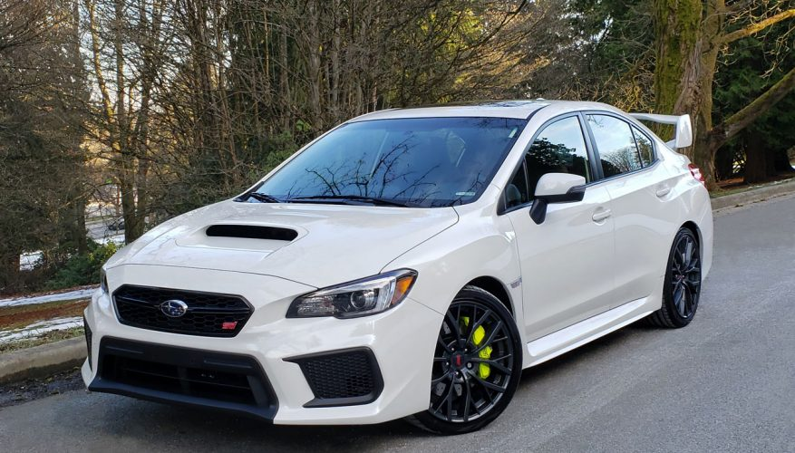
05
Subaru WRX Safety Features
//FASHION PHOTOGRAPHY WORKSHOP

Slide 15
-Safety Feature 1 :
SYMMETRICAL ALL-WHEEL DRIVING
This allows all the weight when driving to be evenly spread amongst all the wheels.
“This provides traction where front- or rear-wheel-drive cars falter.”
//FASHION PHOTOGRAPHY WORKSHOP

Slide 16
-Principle ( B ) :
This is principle B as the Symmetrical All-Wheel-Driving system allows for greater security on the road.
//FASHION PHOTOGRAPHY WORKSHOP

Slide 17
-Safety Feature 2 :
WHIPLASH REDUCING FRONT SEATS
These seats, as well as the head restraints (head rests), are energy-absorbing.
This helps to better protect front occupants from injury during collision from the rear end.
//FASHION PHOTOGRAPHY WORKSHOP

Slide 18
-Principle ( B ) :
Sitting in the front seats means that the seats themselves are the largest area absorbing impact if we focus on that alone. The shock absorbing seats are taking in most of the force of impact so the driver and from passenger stay safe when hit from behind.
//FASHION PHOTOGRAPHY WORKSHOP

Slide 19
-Safety Feature 3 :
SUBARU BOXER ENGINE
The boxer engine provides stability and balancing for turning corners.
“It represents Subaru’s dedication to advanced driving safety”.
//FASHION PHOTOGRAPHY WORKSHOP

Slide 20
-Safety Feature 3 :
SUBARU BOXER ENGINE
If frontal collision is to happen, the lower placement design presses the engine below the ‘cabin’ which reduces the risk of passenger injury.
//FASHION PHOTOGRAPHY WORKSHOP

Slide 21
-Principle ( B ) :
This is principle B as the boxer engine provides and ensures stability for turning corners and on wet roads.
//FASHION PHOTOGRAPHY WORKSHOP

Slide 22
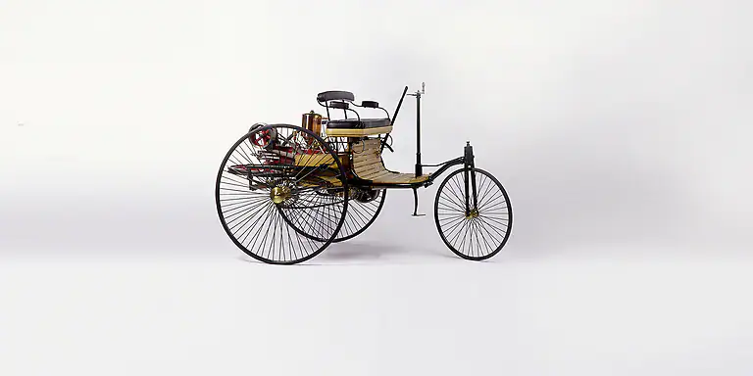
06
Benz Patent Motor Car 1886
//FASHION PHOTOGRAPHY WORKSHOP

Slide 23
-Safety Feature 1 :]
NO DOORS, WALLS, ROOF, SEATBELTS, AIRBAGS OR DASHBOARD
The lack of the key parts of a car provide no safety to the driver if something were to cause impact on the car.
//FASHION PHOTOGRAPHY WORKSHOP

Slide 24
-Safety Feature 1 :]
NO DOORS, WALLS, ROOF SEATBELTS, AIRBAGS OR DASHBOARD
If the vehicle is hit by any force the driver would fly off as there is nothing holding them on the car.
//FASHION PHOTOGRAPHY WORKSHOP

Slide 25
-Principle ( D, B ) :
This is related to principle D and B as there is nothing to keep the driver inside the vehicle as there are no outside parts to the car and there are no seatbelts, and there is nothing to ensure stability or asor and force when collision occurs.
//FASHION PHOTOGRAPHY WORKSHOP

Slide 26
-Safety Feature 2 :
ENGINE IS WEAK AND ON TOP OF THE CAR
This car is run by a very small and weak gas engine that is placed at the back of the car like a basket on the back of a bike.
//FASHION PHOTOGRAPHY WORKSHOP

Slide 27
-Safety Feature 2 :
ENGINE IS WEAK AND ON TOP OF THE CAR
This car has a very simple engine and provides no balance or security for turning or wet roads.
//FASHION PHOTOGRAPHY WORKSHOP

Slide 28
-Principle ( B ) :
This is principle B because unlike the Subaru WRX with its Subaru boxer Engine, the Benz Patent Motor Car has a simple gas engine at the back so there is no stability for turning corners and the engine is likely to break down more easily.
//FASHION PHOTOGRAPHY WORKSHOP

Slide 29
Safety Features of Subaru WRX :
Explore the Subaru WRX Safety Features That Keep You Protected (subaru-global.com)
Safety Features of Ford Thunderbird :
//FASHION PHOTOGRAPHY WORKSHOP

